Slide 1
Web and mobile app development – csc3054/7054
3.3 Home-screen widget

Slide 2
“Appvengers” application
To create a maze style app that is engaging and challenging for the user.
Multiple difficulty levels.
The user guides a ball around the maze via tilting or swiping.
Achievement records and tracking.

Slide 3
What we discussed in the last lectures?
Started working with intents.
Introduced classes to be used in the app.

Slide 4
Questions to be answered
How to create a class or xml file in an app?
What is the value of using the AppWidgetProvider class?
Why shall we create an AppWidget class?
How to make up the code for the AppWidget class?

Slide 5
Content outline
Implementing AppWidgetProvider
Creating widget layout
Summary
Next lecture
Further readings

Slide 6
Basics of appwidgetprovider
The AppWidgetProvider class
implements the onReceive() method;
extracts the required information;
calls the following widget life cycle methods.

Slide 7
Life cycle method
Method | Description
onEnabled() | Called the first time an instance of the widget is added to the home screen.
onDisabled() | Called once the last instance of the widget is removed from the home screen.
onUpdate() | Called for every update of the widget. Contains the ids of appWidgetIds for which an update is needed.
onDeleted() | Widget instance is removed from the home screen.

Slide 8
Implementing the appwidgetprovider class
Open the IDE.
Add a new class to the com.example.silentmodetoggle package and provide a name, e.g. AppWidget.java. This is done by right clicking com.example.silenttogglemode under \java

Slide 9
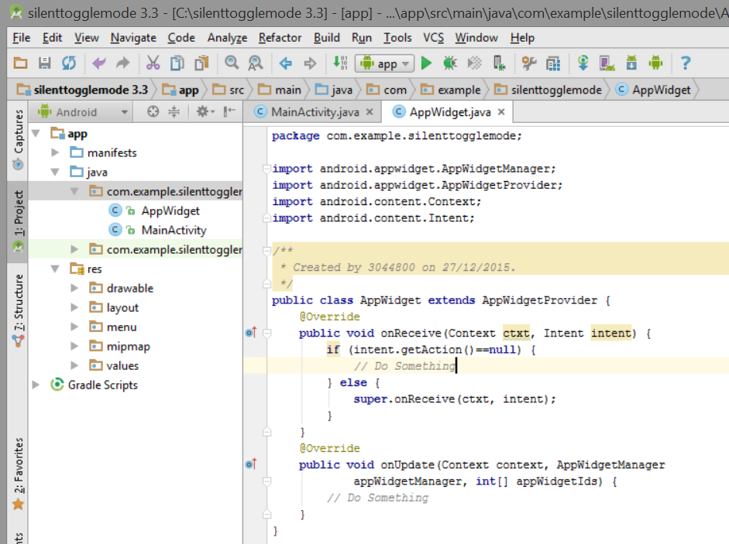
Implementing the appwidgetprovider

Slide 10
Communicating with the app widget
Type the following code into AppWidget.java:
public class AppWidget extends AppWidgetProvider {
@Override
public void onReceive(Context ctxt, Intent intent) {
if (intent.getAction()==null) {
// Do Something
} else {
super.onReceive(ctxt, intent);
}
}
@Override
public void onUpdate(Context context, AppWidgetManager
appWidgetManager, int[] appWidgetIds) {
// Do Something
}
}

Slide 11
Explanation of the code
Line 1: inform Android an class AppWidgetProvider
Line 3: overrides the onReceive() method when a new intent is received from the RemoteView
Line 4: check whether the intent has an action. If no action, then fire off the intent.
Line 6: an action was found in the Intent object so events take place.
Line 7: delegate the work to the super class.
Lines 11-12: onUpdate() is called to allow us to update views

Slide 12
Content outline
Implementing AppWidgetProvider
Creating widget layout
Summary
Next lecture
Further readings

Slide 13
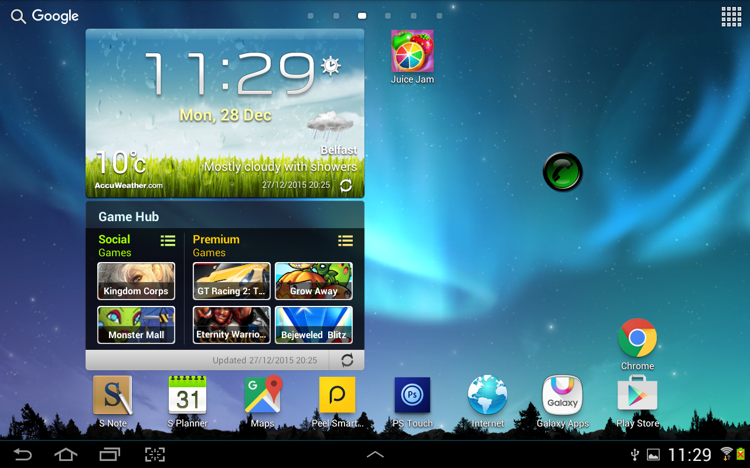
Building app widget’s layout
A special layout is required for the app widget to display

Slide 14
Create widget layout
Create an XML layout file in the res/layouts.
Name it to “widget.xml”.
Widget.xml has the code as follows:
<?xml version=”1.0” encoding=”utf-8”?>
<RelativeLayout
xmlns:android=“http://schemas.android.com/apk/res/android”
android:layout_width=”fill_parent”
android:layout_height=”fill_parent”>
<ImageView android:id=”@+id/phoneState”
android:layout_height=”wrap_content”
android:layout_width=”wrap_content”
android:layout_centerInParent=”true”
android:src=”@drawable/icon”
android:clickable=”true” />
</RelativeLayout>

Slide 15
Code explanation
A RelativeLayout has one child view: a clickable ImageView.
Click this ImageView by setting the clickable property to true.

Slide 16
Implementing appwidgetprovider
public class AppWidget extends AppWidgetProvider {
@Override
public void onReceive(Context context, Intent intent) {
if (intent.getAction()==null) {
context.startService(new Intent(context, ToggleService.class));
} else {
super.onReceive(context, intent);

Slide 17
Code explanation
Line 5: Interface to a global information about an application environment. This allows access to application specific resources.

Slide 18
Implementing appwidgetprovider
}
}
@Override
public void onUpdate(Context context, AppWidgetManager
appWidgetManager, int[] appWidgetIds) {
context.startService(new Intent(context,
ToggleService.class));
}

Slide 19
Content outline
Implementing AppWidgetProvider
Creating widget layout
Summary
Next lecture
Further readings

Slide 20
Summary
Implemented AppWidgetProvider.
Started widget layout.

Slide 21
Content outline
Implementing AppWidgetProvider
Creating widget layout
Summary
Next lecture
Further readings

Slide 22
next lecture
To carry on creating a widget layout.

Slide 23
Content outline
Implementing AppWidgetProvider
Creating widget layout
Summary
Next lecture
Further readings

Slide 24
Further readings
http://developer.android.com/training/index.html
Android Application Development for Dummies, Donn Felker, Wiley Publishing, Inc., NJ, 2011.

